Slide 1
2015 Goal: Win the Class 5A State Championship!
You must make a complete commitment to all the aspects of being an elite cross country runner; mental aspects, physical aspects, nutritional aspects, and you must be a great and hard-working teammate. It will take all of us to reach the goal that has been set for us. It is attainable, but it will not be easy! It will be the hardest thing you have ever done…………..do it Right, do it Together, and Believe it can be done, and things will always work out for the best.
AHMO CC

Slide 2
Commitment by Definition
synonyms: | dedication, devotion, allegiance, loyalty, faithfulness
com·mit·ment
noun
1.
the state of being dedicated to a cause, activity, etc.
What is the CAUSE? WINNING THE STATE CHAMPIONSHIP!!!!!!!!!!!!!!!
synonyms: | responsibility, obligation, duty, tie, liability;

Slide 3
Hydration
Staying Hydrated:
As a runner, you will need approximately 12-14 cups (96-112 oz.) or more water a day, and even more on hot days.
If your urine is clear, then you are hydrated (maybe too well), if your urine is light yellow (lemonade colored) you are hydrated, and dark colored urine (apple juice colored) means you are dehydrated.
Sports Drinks such as Gatorade are best immediately after running to replace certain electrolytes and carbs that have been lost during the run. However, nothing for the long term is better than water.

Slide 4
Nutrition and Hydration Facts:
Carbohydrates
- fuel that allows the runner to run at a higher level
- stored as glycogen in the body; needs to be replaced by eating the right foods
- carbohydrate needs to increase with intensity of training
- carbohydrates should be 55% of your diet
High Carbohydrate Food Choices
Breakfast – Cereal, pancakes, waffles, toast, bagel, oatmeal, grits, orange juice, fruit
Lunch – Low fat sandwiches with Turkey, Ham, or Roast Beef. Pasta with low fat sauce, salad and fruit
Dinner – Potatoes, pasta, rice, Vegetables, salad, fruit
Snacks – Pretzels, fruit, yogurt, energy bars, cereal, Gatorade
Hydration Rules; When and How Much
To Stay hydrated everyday ……………… your weight divided by 2 is about the amount of ounces needed
2-3 hrs. before running ………………….. 17-20 oz. combination water and sports drink (Gatorade)
30 minutes before race …………………. 8-10 oz. water or sports drink (Gatorade)
Post-race or after practice …………….. 24 oz. combination of water and sports drink for every pound of body weight lost during exercise

Slide 5
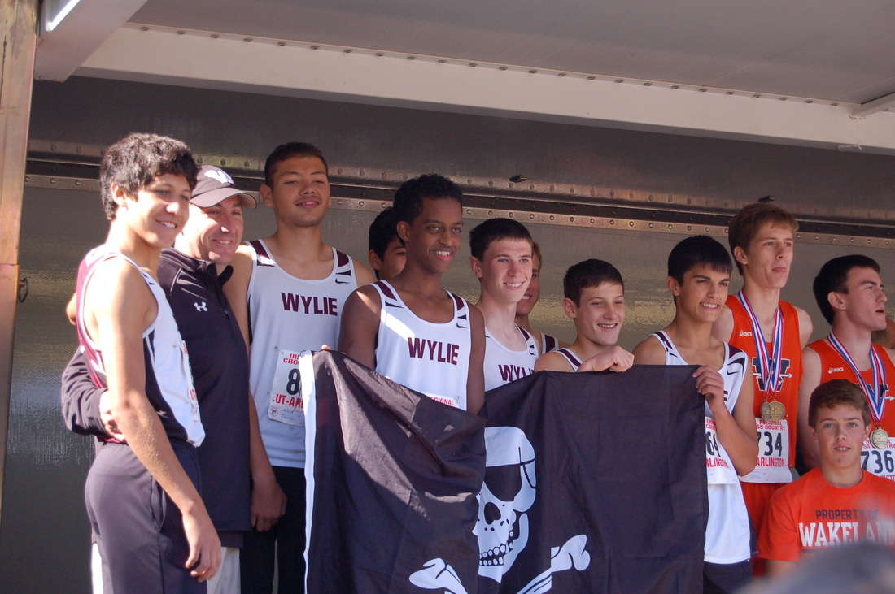

Slide 6
Mental Aspects of Cross Country Running
Attributes of a great teammate:
Physical Aspects of Running:
Dependability
Integrity / Character – what you think does matter
Hard-Working / Never Quit Attitude
Punctual – be on time (Early is on time)
Selfless – always put your team first and protect it!
Strong core = strong connection
Shoes: make sure to get shoes that fit, and change them at least every 500 miles.
Strength training is essential to continued improvement.
Get proper rest and hydration

Slide 7
2015 Cross Country Schedule
Saturday 8/22 Greenhill 6 Mile Relay Addison, TX
Norbuck Park
Saturday 8/29 Plano Invitational Plano, TX
Jasper High School
Saturday 9/5 Southlake Carroll Invitational Southlake, Tx
Bob Jones Park
Saturday 9/12 McKinney Boyd Invitational McKinney, TX
Myers Park
Saturday 9/19 Dustin Rodriquez Run Wylie, TX
WISD Stadium
Saturday 9/26 Lovejoy XC Fall Festival Myers Park
McKinney, TX
Saturday 10/3 Lone Star XC Festival Grand Prairie, TX
Lynn Creek Park @ Joe Pool Lake
Monday 10/19 District 10-5A Championships Myers Park
McKinney, TX
Monday 10/26 Region II-5A Championships Grand Prairie, TX
Lynn Creek Park @ Joe Pool Lake
Saturday 11/7 State Championships Old Settler’s Park
Round Rock, TX

Slide 8
Wylie Pirate Cross Country Expectations:
What you can expect from the coaches:
Consistent, dependable work
Always striving to make you and your teammates better
Pushing you to reach your potential
Pushing you to make your teammates better, and to instill a sense of pride and accomplishment in you; because of the effort and energy you have put into this team
A solid and time tested program that will allow you to compete at the State Level; ANNUALLY!!!!!!!
What your coaches will expect of you:
Punctual, Dependable, and Coachable
Always putting your team ahead of yourself
Allowing us as coaches to push you to make you the best YOU can be
Lifting your teammates and yourself to the highest level of competition
Trust yourself, Trust your program, and Trust your training……ALL we want is ALL YOU GOT!!!!!!!!!!!!!
AHMO CC

Slide 9
Brad.Scoggin@wylieisd.net Kimberly.Campbell@wylieisd.net
Email or call with any questions
AHMO Cross Country
Team

